Slide 1


Dr. Jennifer Young
November 23, 2021

Slide 2
Outline
Executive Summary
Table of Contents
Methodology
Results
Conclusion
Appendix

Slide 3
Executive Summary
The prediction is that the Falcon 9 first stage will land successfully. SpaceX advertises Falcon 9 rocket launches on its website, with a cost of 62 million dollars; other providers cost upward of 165 million dollars each, much of the savings is because SpaceX can reuse the first stage. Therefore, if we can determine if the first stage will land, we can determine the cost of a launch. This information can be used if an alternate company wants to bid against SpaceX for a rocket launch. The goal of this analysis to determine the factors that influence whether the rocket lands successfully, what conditions must be met in order to get the best results and ensure the best rocket success landing rate, and what effect each relationship with rocket variables has in determining the success rate of a successful landing.

Slide 4
Table of Contents
Summary of methodologies
Data collection
Data wrangling
EDA with data visualization
EDA with SQL
Building an interactive map with Folium
Building a Dashboard with Plotly Dash
Predictive analysis (Classification)
Summary of all results
Exploratory data analysis results
Interactive analytics demo in screenshots
Predictive analysis results
Executive Summary

Slide 5
Data collection methodology
SpaceX Rest API
(Web Scrapping) from Wikipedia
Perform data wrangling
One Hot Encoding data fields for Machine Learning and dropping irrelevant columns
Perform exploratory data analysis (EDA) using visualization and SQL
Plotting : Scatter Graphs, Bar Graphs to show relationships between variables to show patterns of data.
Perform interactive visual analytics using Folium and Plotly Dash
Perform predictive analysis using classification models
How to build, tune, evaluate classification models
Methodology

Slide 6
Methodology
I used SpaceX launch data gathered from the SpaceX REST API.
•This API will give us data about launches, information about the rocket used,
payload delivered, launch specifications, landing specifications, and landing outcome.
•The goal is to use this data to predict whether SpaceX will attempt to land a rocket or not.
•The SpaceX REST API endpoints, or URL, starts with api.spacexdata.com/v4/.
•Another popular data source for obtaining Falcon 9 Launch data is web scraping
Wikipedia using BeautifulSoup.
Use SpaceX REST API
SpaceX API
Use SpaceX REST API
API returns data in .JSON
Convert data into.csv
Get HTML Response from Wikipedia
Extract data using beautiful soup
https://github.com/datatitanic/capstone1/blob/7c590711964500163429fe63bbabe65fb3d172b8/Capstone/assets/notebook/API.ipynb
Normalize data into flat data file such as .csv7

Slide 7

https://github.com/datatitanic/capstone1/blob/7c590711964500163429fe63bbabe65fb3d172b8/Capstone/assets/notebook/API.ipynb
Data Collection – SpaceX API
Getting response from API Create a dataframe from dictionary spacex_url=https://api.spacexdata.com/v4/launches/past response = requests.get(spacex_url)|
Converting response to a .json file response.json() data = pd.json_normalize(response.json()) print(data)
Clean data by applying functions
# Call getBoosterVersion getBoosterVersion(data) # Call getLaunchSite getLaunchSite(data) # Call getPayloadDat getPayloadData(data) # Call getCoreData getCoreData(data)
launch_dict = {'FlightNumber': list(data['flight_number']),
'Date': list(data['date']),
'BoosterVersion':BoosterVersion,
'PayloadMass':PayloadMass,
'Orbit':Orbit,
'LaunchSite':LaunchSite,
'Outcome':Outcome,
'Flights':Flights,
'GridFins':GridFins,
'Reused':Reused,
'Legs':Legs,
'LandingPad':LandingPad,
'Block':Block,
'ReusedCount':ReusedCount,
'Serial':Serial,
'Longitude': Longitude,
'Latitude': Latitude}
Filter dataframe and export to flat file (.csv) data_falcon9= df_launch[df_launch['BoosterVersion']!='Falcon 1']
data_falcon9.to_csv('dataset_part_1.csv', index=False)

Slide 8
Data Wrangling
There are several different cases where the booster did not land successfully within this dataset. Sometimes, a landing was attempted but failed due to an accident.
True Ocean means the mission outcome was successfully landed to a specific region of the ocean.
False Ocean means the mission outcome was unsuccessfully landed to a specific region of the ocean.
True RTLS indicates that the mission outcome was successfully landed to a ground pad.
False RTLS indicates that the mission outcome was unsuccessfully landed to a ground pad.
True ASDS indicates that the mission outcome was successfully landed on a drone ship.
False ASDS indicates that the mission outcome was unsuccessfully landed on a drone ship.
These outcomes are converted to Training Labels with 1, which means the booster successfully landed. A zero (0) means it was unsuccessful.
https://github.com/datatitanic/capstone1/blob/7ed3ee6496d7426e2962b892176d9d8150b358a8/Capstone/assets/notebook/notebook:Data_Wrangling_NvseP8d83.ipynb

Slide 9
Data Wrangling
The
Process
Calculate the number of launches at each site
Calculate the number and occurrence of mission outcome per orbit type
Export dataset as .CSV
Calculate the number and occurrence of each orbit
Create a landing outcome label from Outcome column
Work out success rate for every landing in dataset
Github link:
https://github.com/datatitanic/capstone1/blob/7ed3ee6496d7426e2962b892176d9d8150b358a8/Capstone/assets/notebook/notebook:Data_Wrangling_NvseP8d83.ipynb

Slide 10
EDA with Data Visualization
Scatter Graphs being drawn:
Bar Graph being drawn:
Mean vs. Orbit
Line Graph being drawn:
Success Rate vs. Year
Line graphs are useful in that they show data variables and trends very clearly and can help to make predictions about the results of data.
A bar diagram makes it easy to compare sets of data between different groups The graph represents categories on one axis and a discrete value in the other. The goal is to show the relationship between the two axes. Bar charts can also show big changes in data over time.
Flight Number vs. Payload Mass
Flight Number vs. Launch Site
Payload vs. Launch Site
Orbit vs. Flight Number
Payload vs. Orbit Type
Orbit vs. Payload Mass
Scatter plots demonstrate how one variable is influenced by another. The relationship between two variables is called their correlation. Scatter plots usually consist of a large amount of data.
:
https://github.com/datatitanic/capstone1/blob/7c590711964500163429fe63bbabe65fb3d172b8/Capstone/assets/notebook/notebook:Visualization_K7xLiT_Pi.ipynb

Slide 11
We used SQL queries to get the answers in the dataset :
•Displaying the names of the unique launch sites in the space mission %sql select Unique(LAUNCH_SITE) from SPACEXTBL;
•Displaying 5 records where launch sites begin with the string 'KSC’ %sql SELECT LAUNCH_SITE from SPACEXTBL where (LAUNCH_SITE) LIKE 'CCA%' LIMIT 5;
•Displaying the total payload mass carried by boosters launched by NASA (CRS) %sql select sum(PAYLOAD_MASS__KG_) as payloadmass from SPACEXTBL;
•Displaying average payload mass carried by booster version F9 v1.1 %sql select avg(PAYLOAD_MASS__KG_) as payloadmass from SPACEXTBL;
•Listing the date where the successful landing outcome in ground pad was achieved. %sql select min(DATE) from SPACEXTBL;
•Listing the names of the boosters which have success in ground pad and have payload mass greater than 4000 but less than 6000 %sql select BOOSTER_VERSION from SPACEXTBL where LANDING__OUTCOME='Success (drone ship)' and PAYLOAD_MASS__KG_ BETWEEN 4000 and 6000;
•Listing the total number of successful and failure mission outcomes %sql select count(MISSION_OUTCOME) as missionoutcomes from SPACEXTBL GROUP BY MISSION_OUTCOME;
•Listing the names of the booster_versions which have carried the maximum payload mass. %sql select BOOSTER_VERSION as boosterversion from SPACEXTBL where PAYLOAD_MASS__KG_=(select max(PAYLOAD_MASS__KG_) from SPACEXTBL);
•Listing the records which will display the month names, successful landing_outcomesin ground pad ,booster versions, launch_sitefor the months in year 2017 %sql SELECT MONTH(DATE),MISSION_OUTCOME,BOOSTER_VERSION,LAUNCH_SITE FROM SPACEXTBL where EXTRACT(YEAR FROM DATE)='2015';
•Ranking the count of successful landing_outcomesbetween the date 2010-06-04 and 2017-03-20 in descending order. %sql SELECT LANDING__OUTCOME FROM SPACEXTBL WHERE DATE BETWEEN '2010-06-04' AND '2017-03-20' ORDER BY DATE DESC;
Github link:
https://github.com/datatitanic/capstone1/blob/7c590711964500163429fe63bbabe65fb3d172b8/Capstone/assets/notebook/notebook:EDA_SQL_3lPc1BDS9.ipynb
EDA with SQL

Slide 12

Build an Interactive Map with Folium
To visualize the Launch Data into an interactive map. We took the Latitude and Longitude Coordinates at each launch site and added a Circle Marker around each launch site with a label of the name of the launch site.
We assigned the dataframe launch_outcomes(failures, successes) to classes 0 and 1with Greenand Redmarkers on the map in a MarkerCluster()
Using Haversine’s formula we calculated the distance from the Launch Site to various landmarks to find various trends about what is around the Launch Site to measure patterns. Lines are drawn on the map to measure distance to landmarks
Example of some trends in which the Launch Site is situated in.
•Are launch sites in close proximity to railways? No
•Are launch sites in close proximity to highways? No
•Are launch sites in close proximity to coastline? Yes
•Do launch sites keep certain distance away from cities? Yes
Github link: https://github.com/datatitanic/capstone1/blob/7ed3ee6496d7426e2962b892176d9d8150b358a8/Capstone/assets/notebook/notebook:Visualization_with_folium_labs__eCHFi3Nz.ipynb

Slide 13
Build a Dashboard with Plotly Dash
Used Lab to build a Dashboard with Plotly Dash
Created a Pie Chart that shows the total launches by a certain site/all
sites
- Demonstrates the relative proportions of data classes
Scatter Graph showing the relationship with Outcome and Payload Mass (Kg) for the different Booster Versions
Important because it illustrates the relationship between two variables. - Observation of minimum and maximum data points is obvious
Most effective method to show a non-linear pattern.
https://github.com/datatitanic/capstone1/blob/7ed3ee6496d7426e2962b892176d9d8150b358a8/Capstone/assets/notebook/notebook:Visualization_with_folium_labs__eCHFi3Nz.ipynb

Slide 14
BUILDING MODEL
•Load our dataset into NumPy and Pandas
•Convert Data
•Split our data into training and test data sets
•Find out how many test samples we have
•Choose which type of machine learning algorithms we want to use
•Set our parameters and algorithms to GridSearchCV
•Fit our datasets into the GridSearchCVobjects and train our dataset.
CHECKING MODEL
•Check accuracy for each model
•Get tuned hyperparameters for each type of algorithms
•Plot the Confusion Matrix
IMPROVING MODEL
•Feature Engineering
•Algorithm Tuning
FINDING THE BEST PERFORMING CLASSIFICATION MODEL
•The model with the best accuracy score wins the best performing model
Github link: https://github.com/datatitanic/capstone1/blob/7ed3ee6496d7426e2962b892176d9d8150b358a8/Capstone/assets/notebook/notebook:Machine_Learning_Prediction_6d7EKa2Jc.ipynb
Predictive Analysis (Classification)

Slide 15

Results
Interactive analytics demo with screenshots
Exploratory data analysis findings
Predictive analysis findings

Slide 16


Slide 17
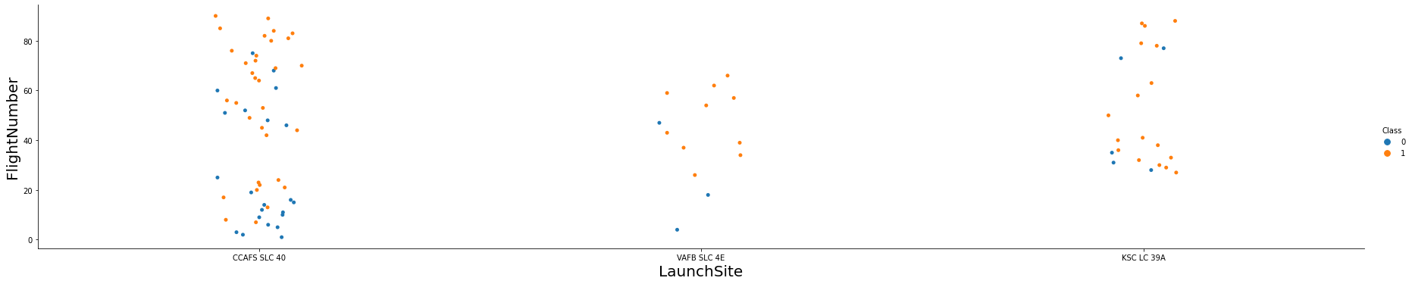
Flight Number vs. Launch Site
The more flights at a launch site the greater the success rate at a launch site.
https://github.com/datatitanic/capstone1/blob/7c590711964500163429fe63bbabe65fb3d172b8/Capstone/assets/notebook/notebook:Visualization_K7xLiT_Pi.ipynb

Slide 18
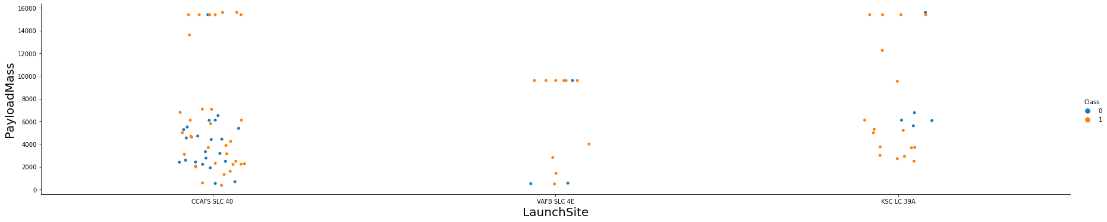
Payload vs. Launch Site
The greater the payload mass for Launch Site CCAFS SLC 40 the higher the success rate for the Rocket. There is not quite a clear pattern to be found using this visualization to make a decision if the Launch Site is dependent on Pay Load Mass for a success launch.
https://github.com/datatitanic/capstone1/blob/7c590711964500163429fe63bbabe65fb3d172b8/Capstone/assets/notebook/notebook:Visualization_K7xLiT_Pi.ipynb

Slide 19
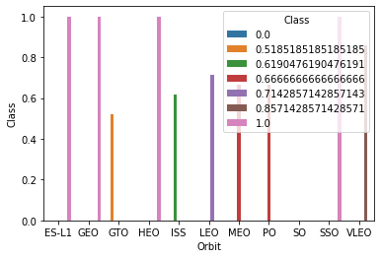
Success Rate vs. Orbit Type
Orbit GEO,HEO,SSO,ES-L1 has the best Success Rate
https://github.com/datatitanic/capstone1/blob/7c590711964500163429fe63bbabe65fb3d172b8/Capstone/assets/notebook/notebook:Visualization_K7xLiT_Pi.ipynb

Slide 20
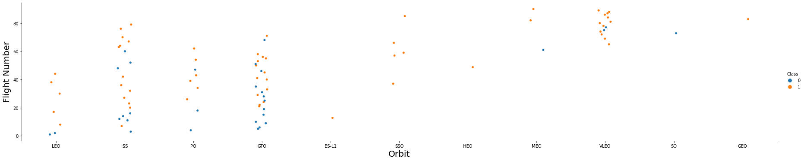
Orbit GEO,HEO,SSO,ES-L1 has the best Success Rate
Flight Number vs. Orbit Type
In the LEO orbit the Success appears related to the number of flights; on the other hand, there seems to be no relationship between flight number when in GTO orbit.
https://github.com/datatitanic/capstone1/blob/7c590711964500163429fe63bbabe65fb3d172b8/Capstone/assets/notebook/notebook:Visualization_K7xLiT_Pi.ipynb

Slide 21
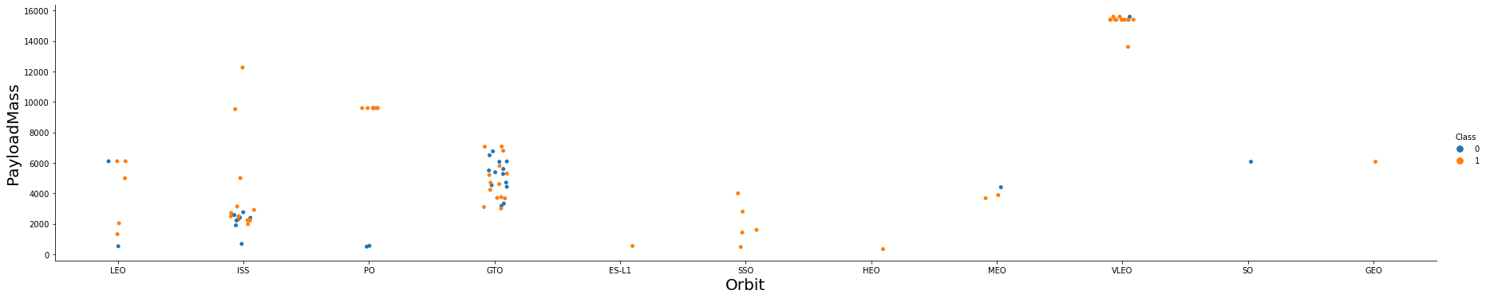
Payload vs. Orbit Type
Heavy payloads have a negative influence on GTO orbits and positive on GTO and Polar LEO (ISS) orbits.
https://github.com/datatitanic/capstone1/blob/7c590711964500163429fe63bbabe65fb3d172b8/Capstone/assets/notebook/notebook:Visualization_K7xLiT_Pi.ipynb

Slide 22
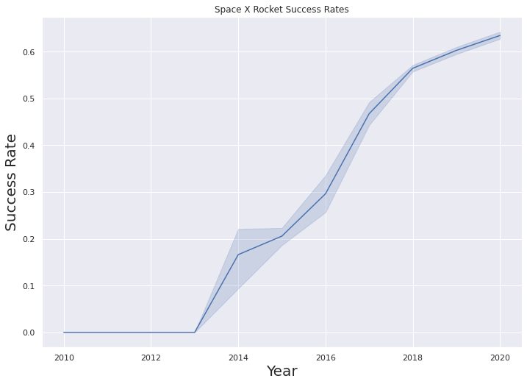
Yearly launch success rate
Observe that the success rate since 2013 kept increasing until 2020
https://github.com/datatitanic/capstone1/blob/7c590711964500163429fe63bbabe65fb3d172b8/Capstone/assets/notebook/notebook:Visualization_K7xLiT_Pi.ipynb

Slide 23
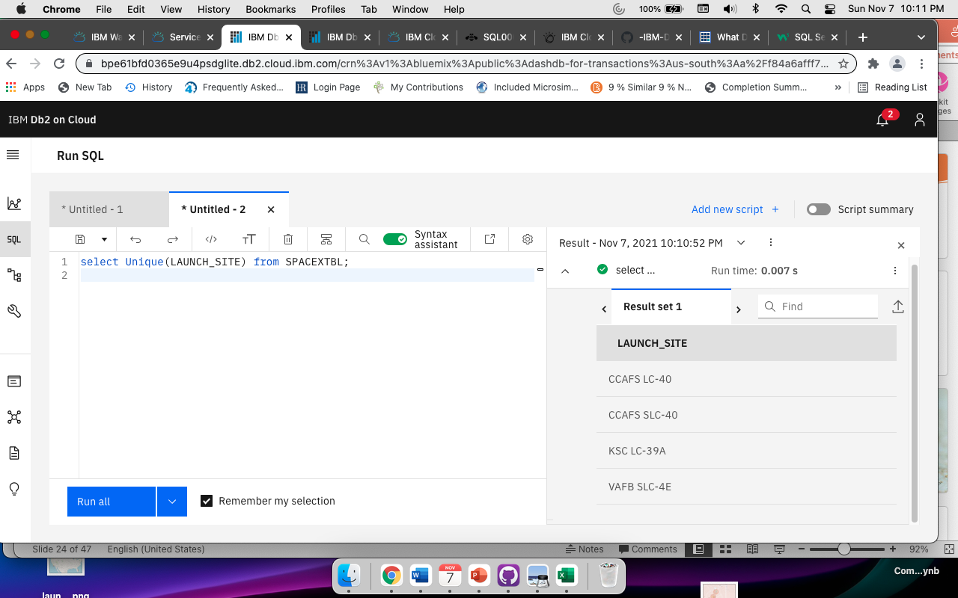
All Launch Site Names
Using the word DISTINCT in the query means that it will only show unique values in the Launch_Site
https://github.com/datatitanic/capstone1/blob/7c590711964500163429fe63bbabe65fb3d172b8/Capstone/assets/notebook/notebook:EDA_SQL_3lPc1BDS9.ipynb

Slide 24

Launch Site Names Begin with 'CCA'
Using the word TOP 5 in the query means that it will only show 5 records and LIKE keyword has a wild card with the words ‘KSC%’ the percentage in the end means that the Launch_Site name must start with KSC.
https://github.com/datatitanic/capstone1/blob/7c590711964500163429fe63bbabe65fb3d172b8/Capstone/assets/notebook/notebook:EDA_SQL_3lPc1BDS9.ipynb

Slide 25
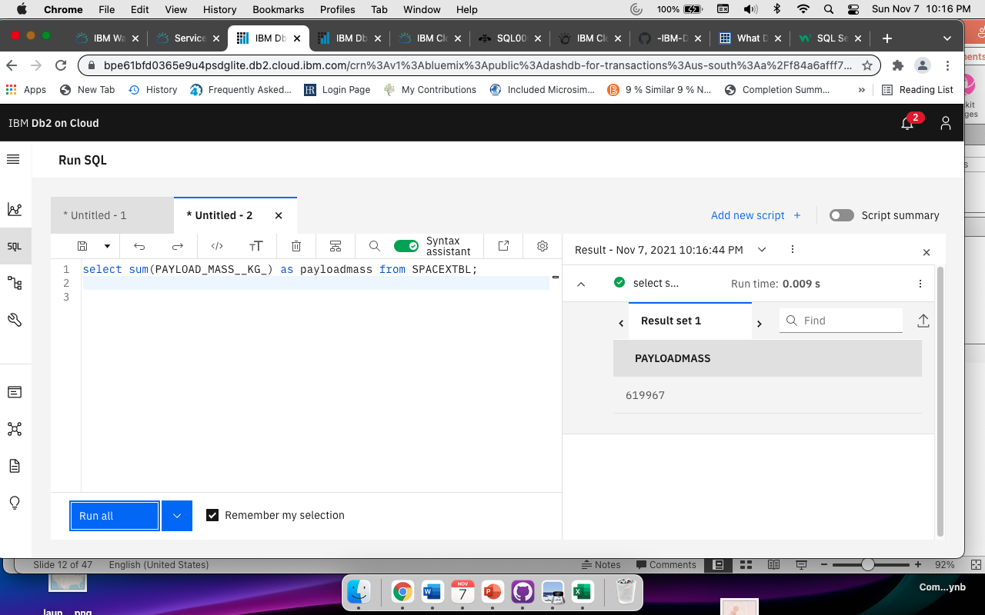
The WHERE clause filters the dataset to only perform calculations on (CRS
Total Payload Mass
https://github.com/datatitanic/capstone1/blob/7c590711964500163429fe63bbabe65fb3d172b8/Capstone/assets/notebook/notebook:EDA_SQL_3lPc1BDS9.ipynb

Slide 26
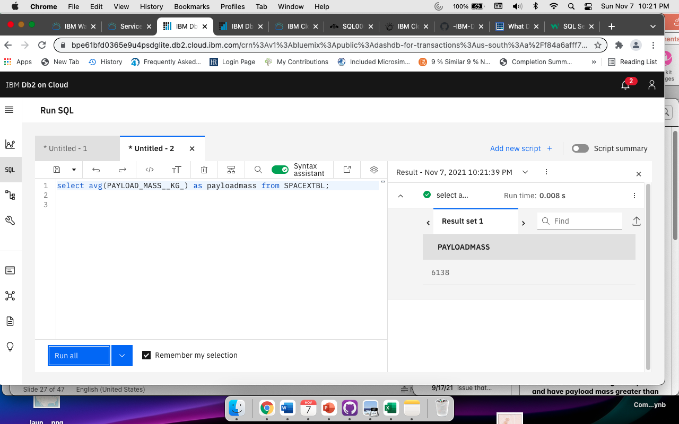
Average Payload Mass by F9 v1.1
Using the function AVG works out the average in the column PAYLOAD_MASS_KG_
The WHERE clause filters the dataset to only perform calculations on Booster_version F9 v1.1
https://github.com/datatitanic/capstone1/blob/7c590711964500163429fe63bbabe65fb3d172b8/Capstone/assets/notebook/notebook:EDA_SQL_3lPc1BDS9.ipynb

Slide 27
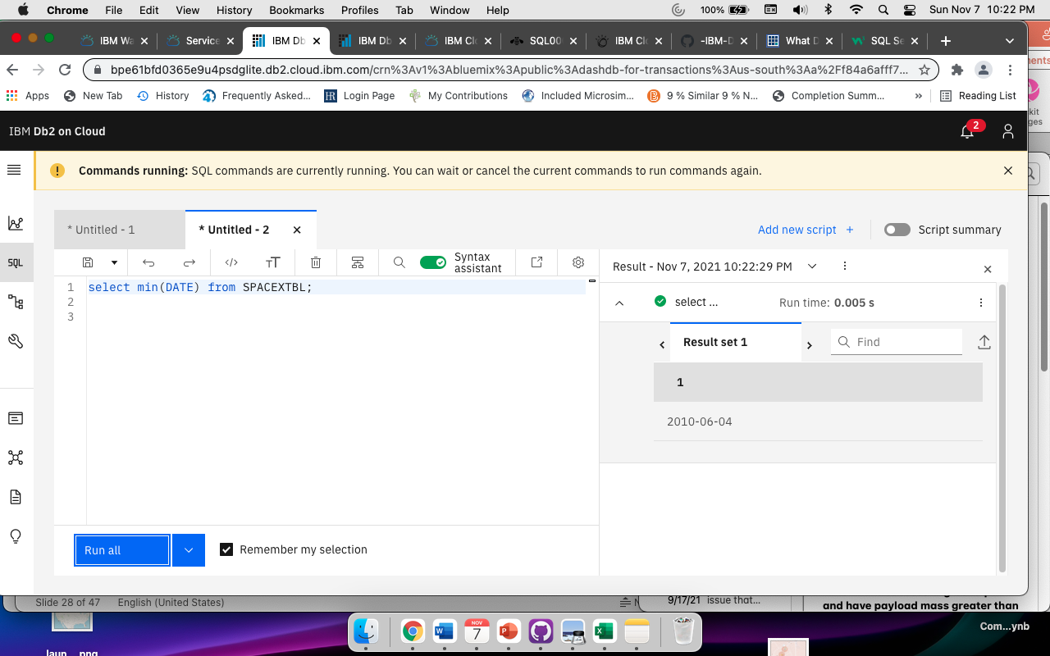
First Successful Ground Landing Date
Using the function MIN works out the minimum date in the column Date
https://github.com/datatitanic/capstone1/blob/7c590711964500163429fe63bbabe65fb3d172b8/Capstone/assets/notebook/notebook:EDA_SQL_3lPc1BDS9.ipynb

Slide 28
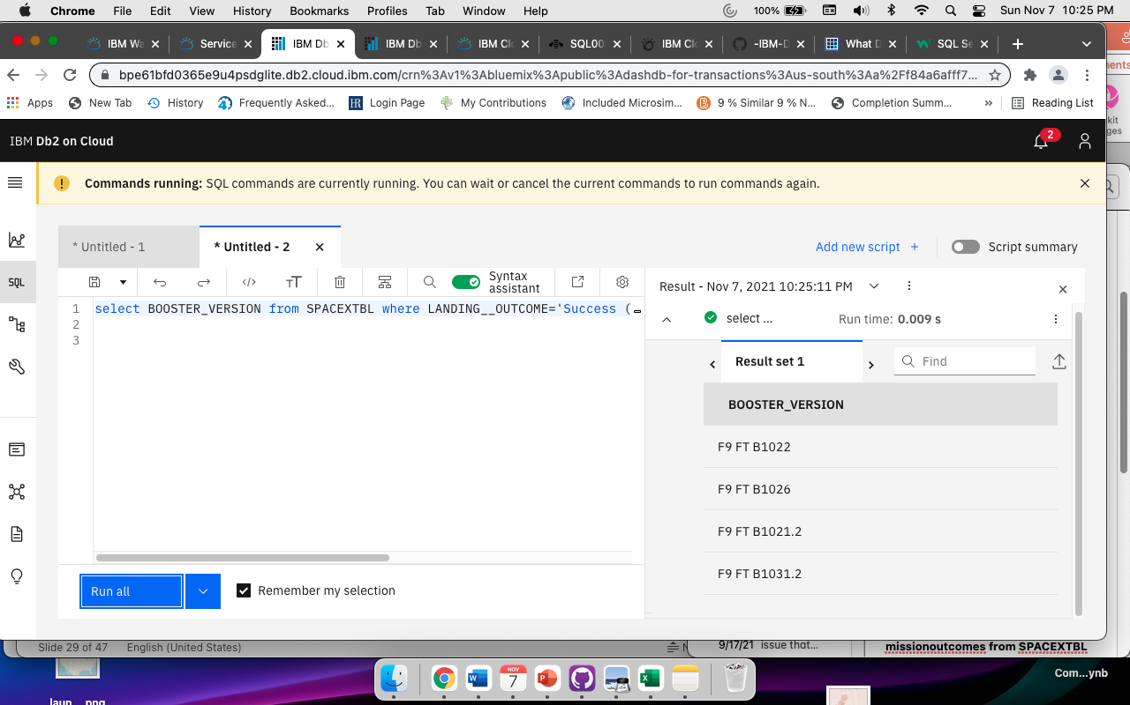
Successful Drone Ship Landing with Payload between 4000 and 6000
Choosing only Booster_Version The WHERE clause filters the dataset to Landing_Outcome = “Success"
https://github.com/datatitanic/capstone1/blob/7c590711964500163429fe63bbabe65fb3d172b8/Capstone/assets/notebook/notebook:EDA_SQL_3lPc1BDS9.ipynb

Slide 29
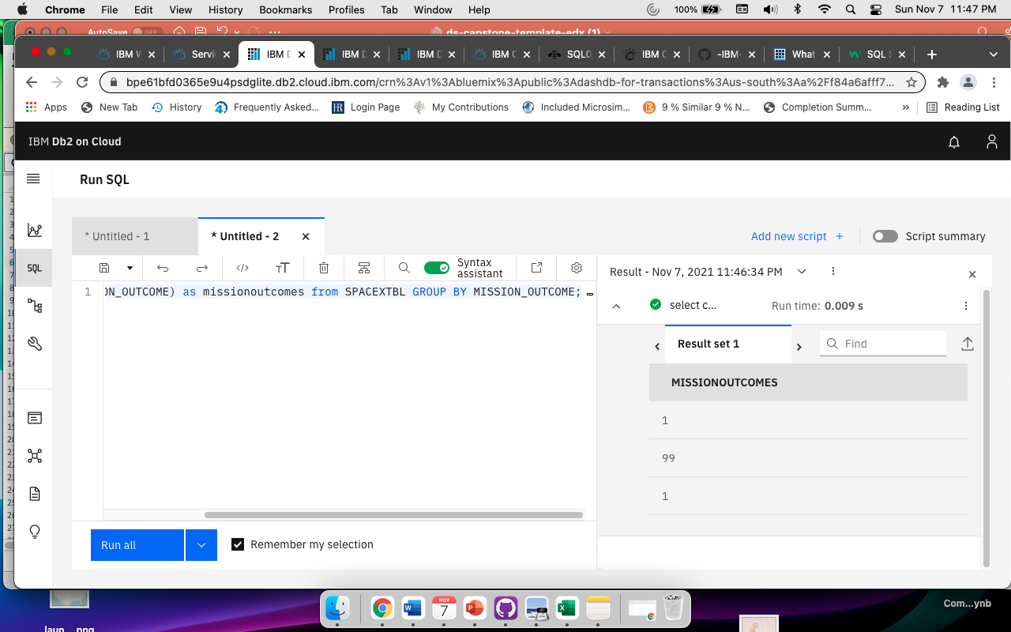
Total Number of Successful and Failure Mission Outcomes
https://github.com/datatitanic/capstone1/blob/7c590711964500163429fe63bbabe65fb3d172b8/Capstone/assets/notebook/notebook:EDA_SQL_3lPc1BDS9.ipynb

Slide 30
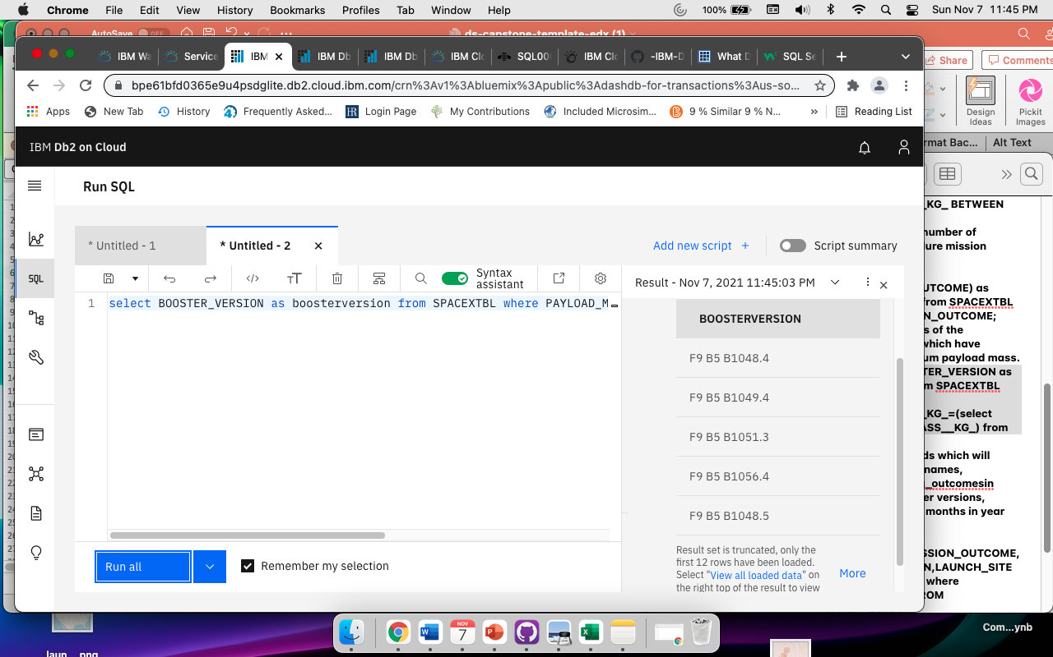
Boosters Carried Maximum Payload
https://github.com/datatitanic/capstone1/blob/7c590711964500163429fe63bbabe65fb3d172b8/Capstone/assets/notebook/notebook:EDA_SQL_3lPc1BDS9.ipynb

Slide 31
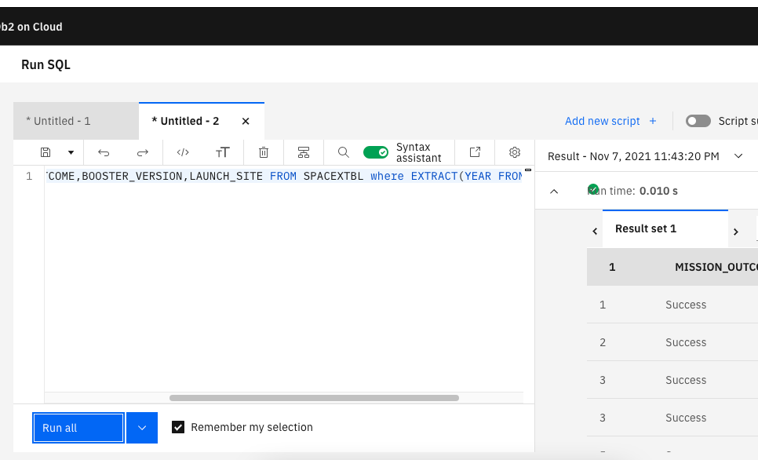
2017 Launch Records
Query Successes and Failures in a specific year
https://github.com/datatitanic/capstone1/blob/7c590711964500163429fe63bbabe65fb3d172b8/Capstone/assets/notebook/notebook:EDA_SQL_3lPc1BDS9.ipynb

Slide 32
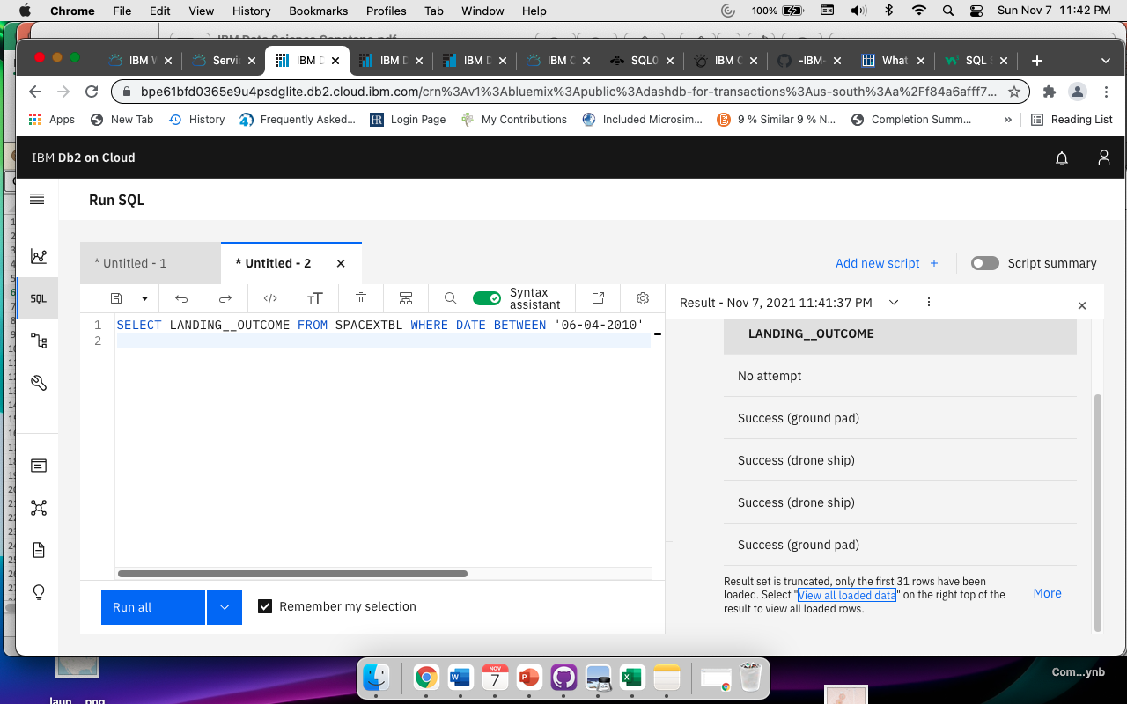
Rank Landing Outcomes Between 2010-06-04 and 2017-03-20
Selected landing outcomes from a specific time period and ranked them.
https://github.com/datatitanic/capstone1/blob/7c590711964500163429fe63bbabe65fb3d172b8/Capstone/assets/notebook/notebook:EDA_SQL_3lPc1BDS9.ipynb

Slide 33


Slide 34

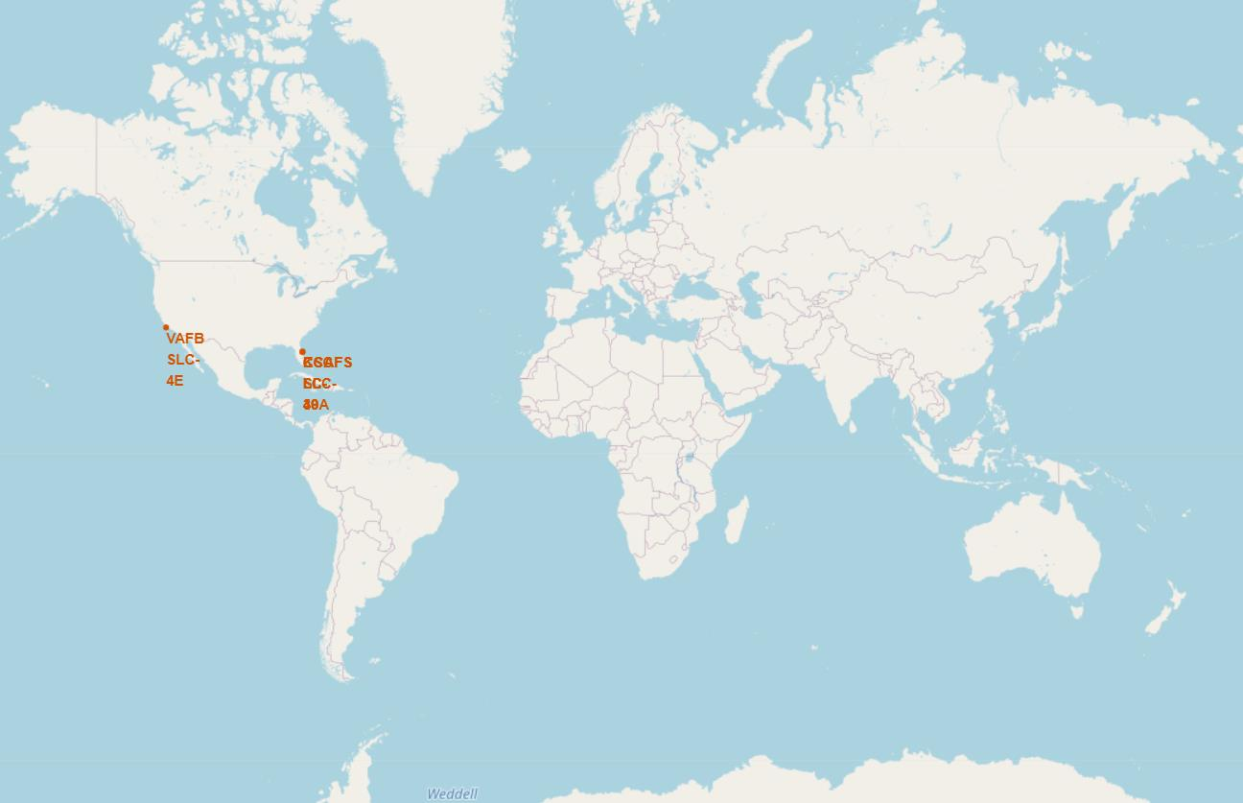
Map of SpaceX launch sites
SpaceX launch sites are located in California and Florida
https://github.com/datatitanic/capstone1/blob/7ed3ee6496d7426e2962b892176d9d8150b358a8/Capstone/assets/notebook/notebook:Visualization_with_folium_labs__eCHFi3Nz.ipynb

Slide 35
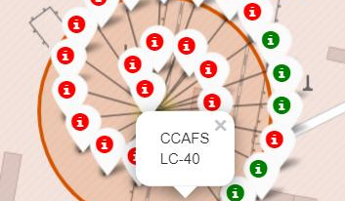
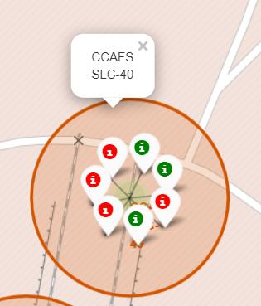
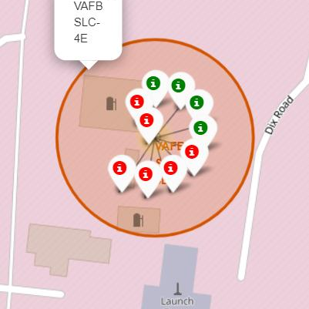

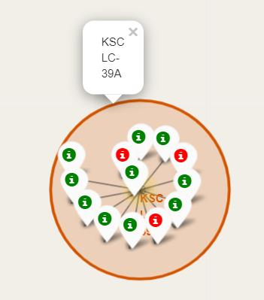
Success/failed launches for each site on the map

Slide 36
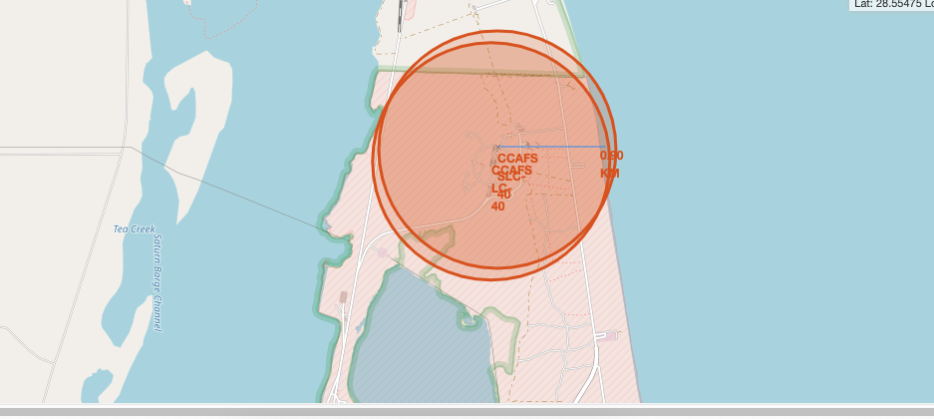
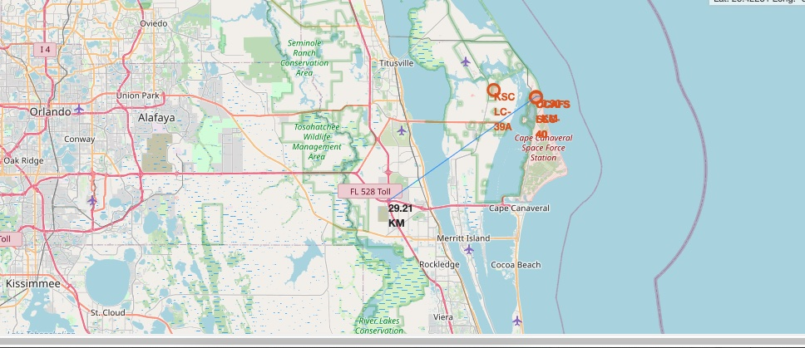
Distances between a launch site to coastline and highway
Launch Sites distance to highway and coastline
https://github.com/datatitanic/capstone1/blob/7ed3ee6496d7426e2962b892176d9d8150b358a8/Capstone/assets/notebook/notebook:Visualization_with_folium_labs__eCHFi3Nz.ipynb

Slide 37


Slide 38
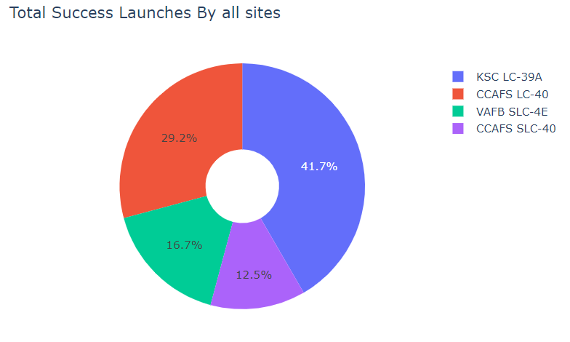
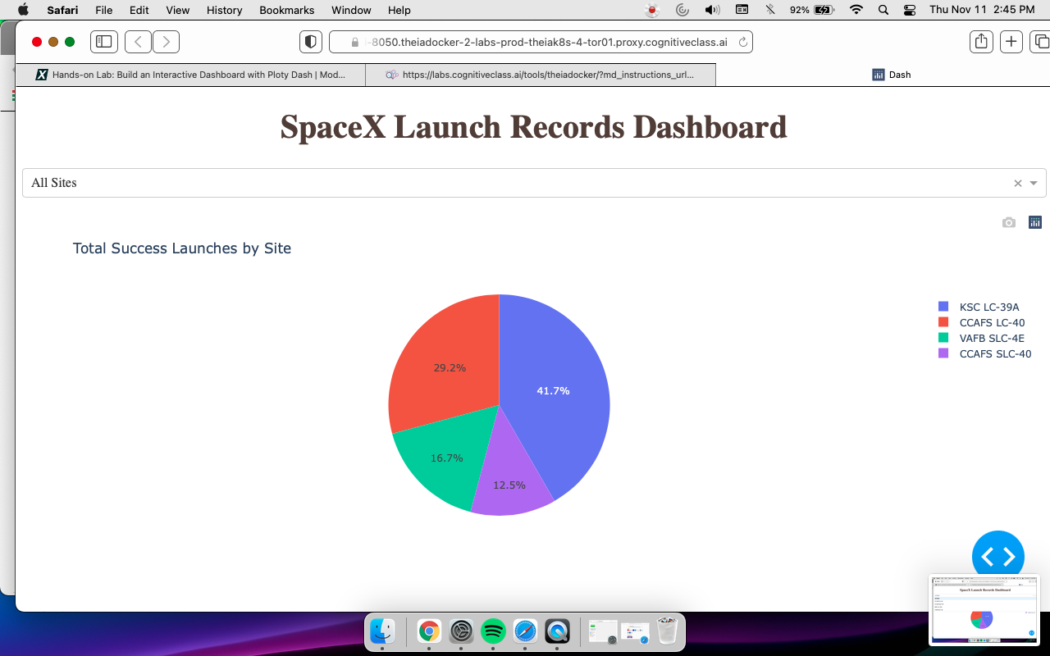
SpaceX Launch Pie Chart – Most successful launch site
KSC LC-39A had the most successful launches from all the sites
https://github.com/datatitanic/capstone1/blob/7ed3ee6496d7426e2962b892176d9d8150b358a8/Capstone/assets/notebook/notebook:Dashboard_UfLCGp64k.ipynb

Slide 39
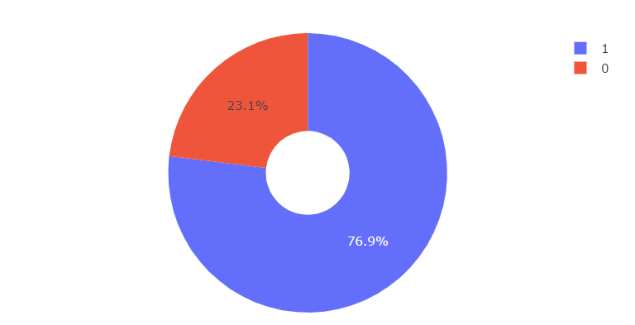
SpaceX Launch Records Pie Chart-Success Rate
KSC LC-39A achieved a 76.9% success rate while getting a 23.1% failure rate
https://github.com/datatitanic/capstone1/blob/7ed3ee6496d7426e2962b892176d9d8150b358a8/Capstone/assets/notebook/notebook:Dashboard_UfLCGp64k.ipynb

Slide 40
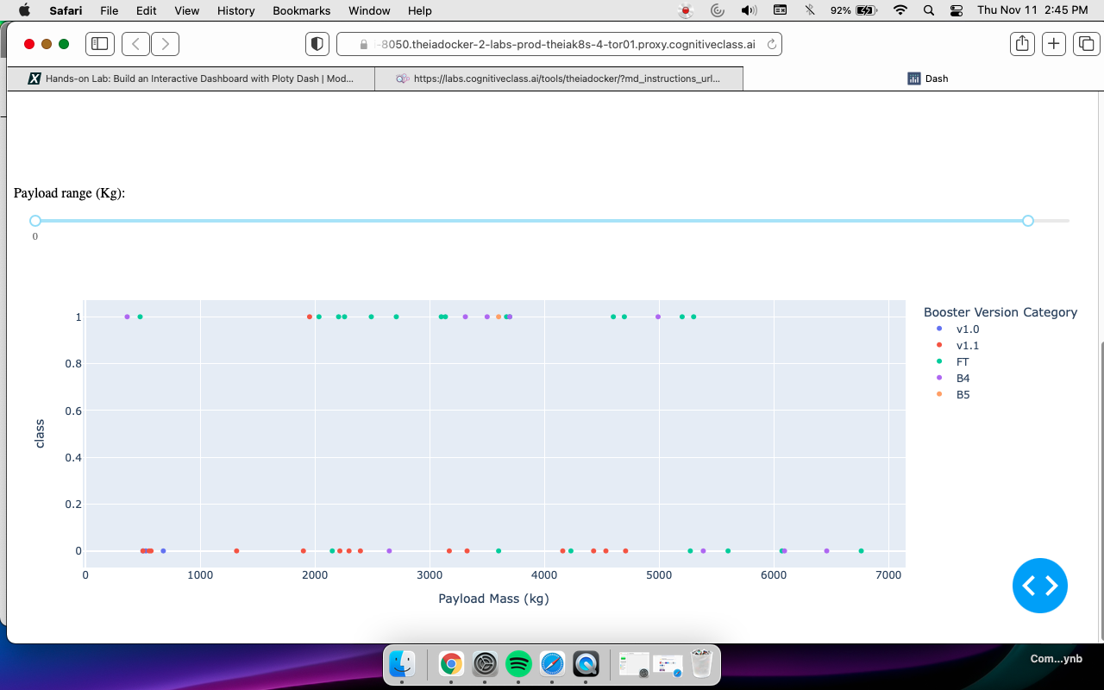
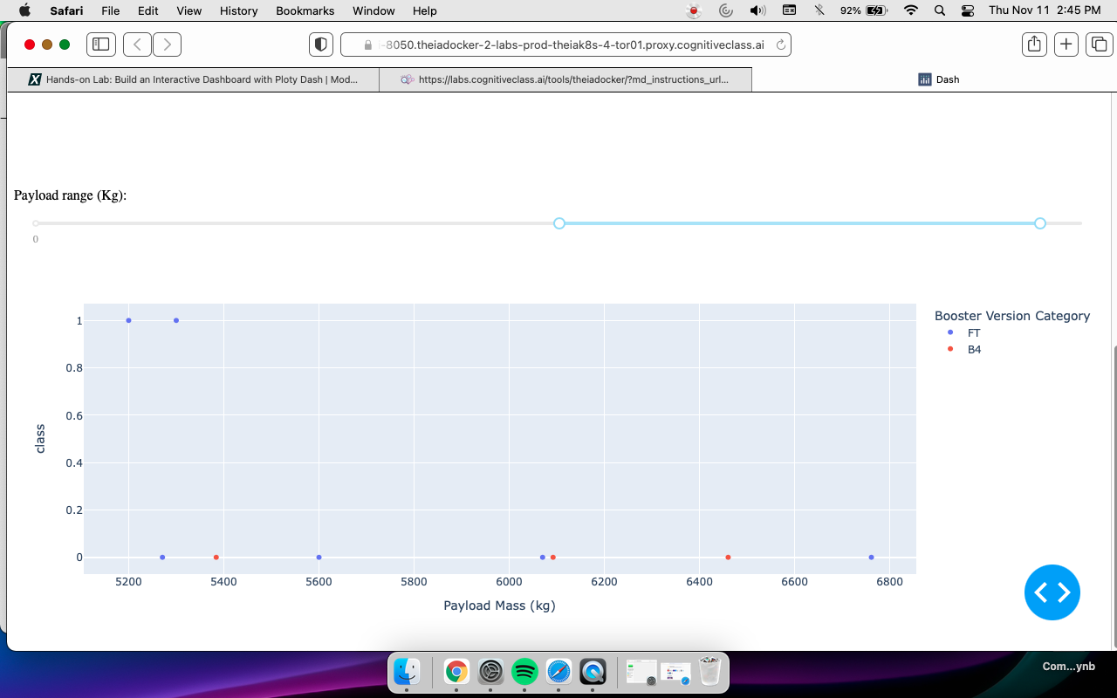
Payload vs. Launch Outcome scatter plot for all sites
Low weighted payloads success rate is higher than the heavy weighted payloads
https://github.com/datatitanic/capstone1/blob/7ed3ee6496d7426e2962b892176d9d8150b358a8/Capstone/assets/notebook/notebook:Dashboard_UfLCGp64k.ipynb

Slide 41


Slide 42
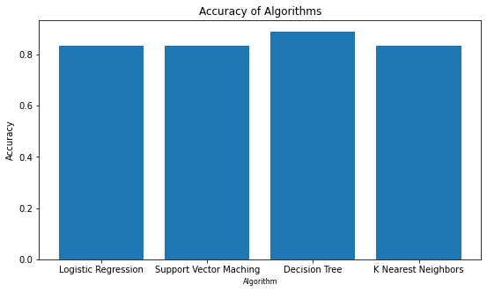
Classification Accuracy
After selecting the best hyperparameters for the decision tree classifier using the validation data, we achieved 88% accuracy on the test data.
https://github.com/datatitanic/capstone1/blob/7ed3ee6496d7426e2962b892176d9d8150b358a8/Capstone/assets/notebook/notebook:Machine_Learning_Prediction_6d7EKa2Jc.ipynb

Slide 43
Confusion Matrix
Examining the confusion matrix, we see that Tree can distinguish between the different classes. We see that the major problem is false positives.
https://github.com/datatitanic/capstone1/blob/7ed3ee6496d7426e2962b892176d9d8150b358a8/Capstone/assets/notebook/notebook:Machine_Learning_Prediction_6d7EKa2Jc.ipynb

Slide 44
Conclusions
The Tree Classifier Algorithm is the best for Machine Learning for this dataset
Low weighted payloads perform better than the heavier payloads
KSC LC-39A had the most successful launches from all the sites
Orbit GEO,HEO,SSO,ES-L1 has the best Success Rate

Slide 45
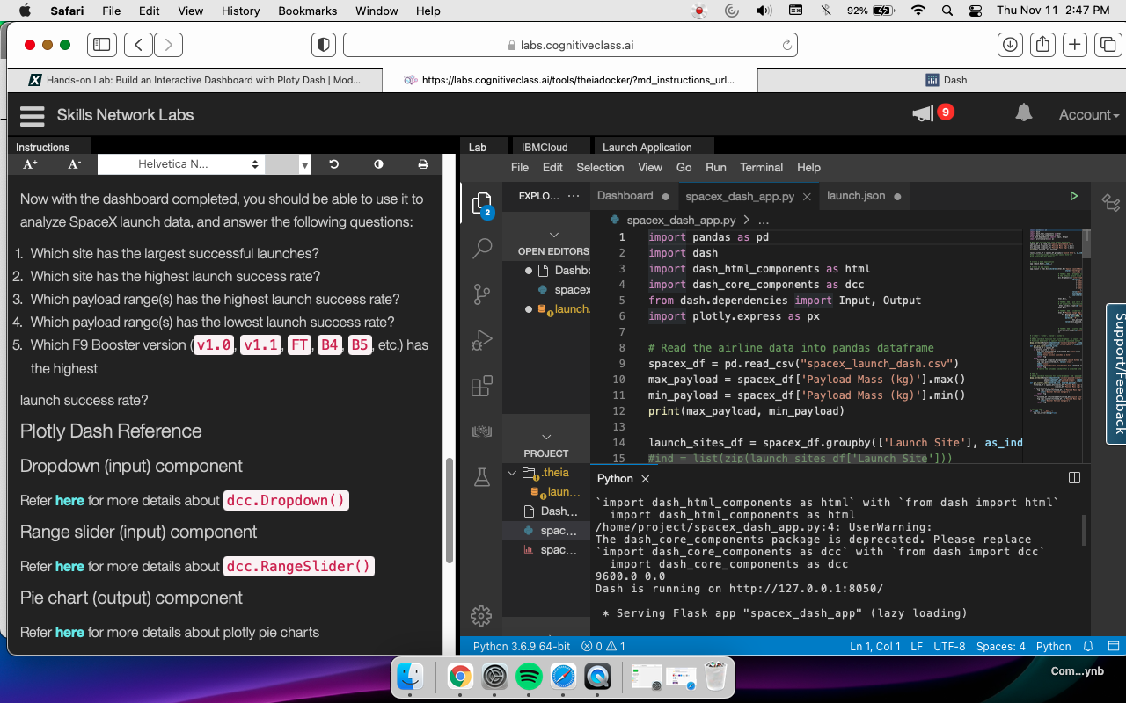
Appendix
Using the Lab to create the Dashboard on SN

Slide 46


